Slide 1
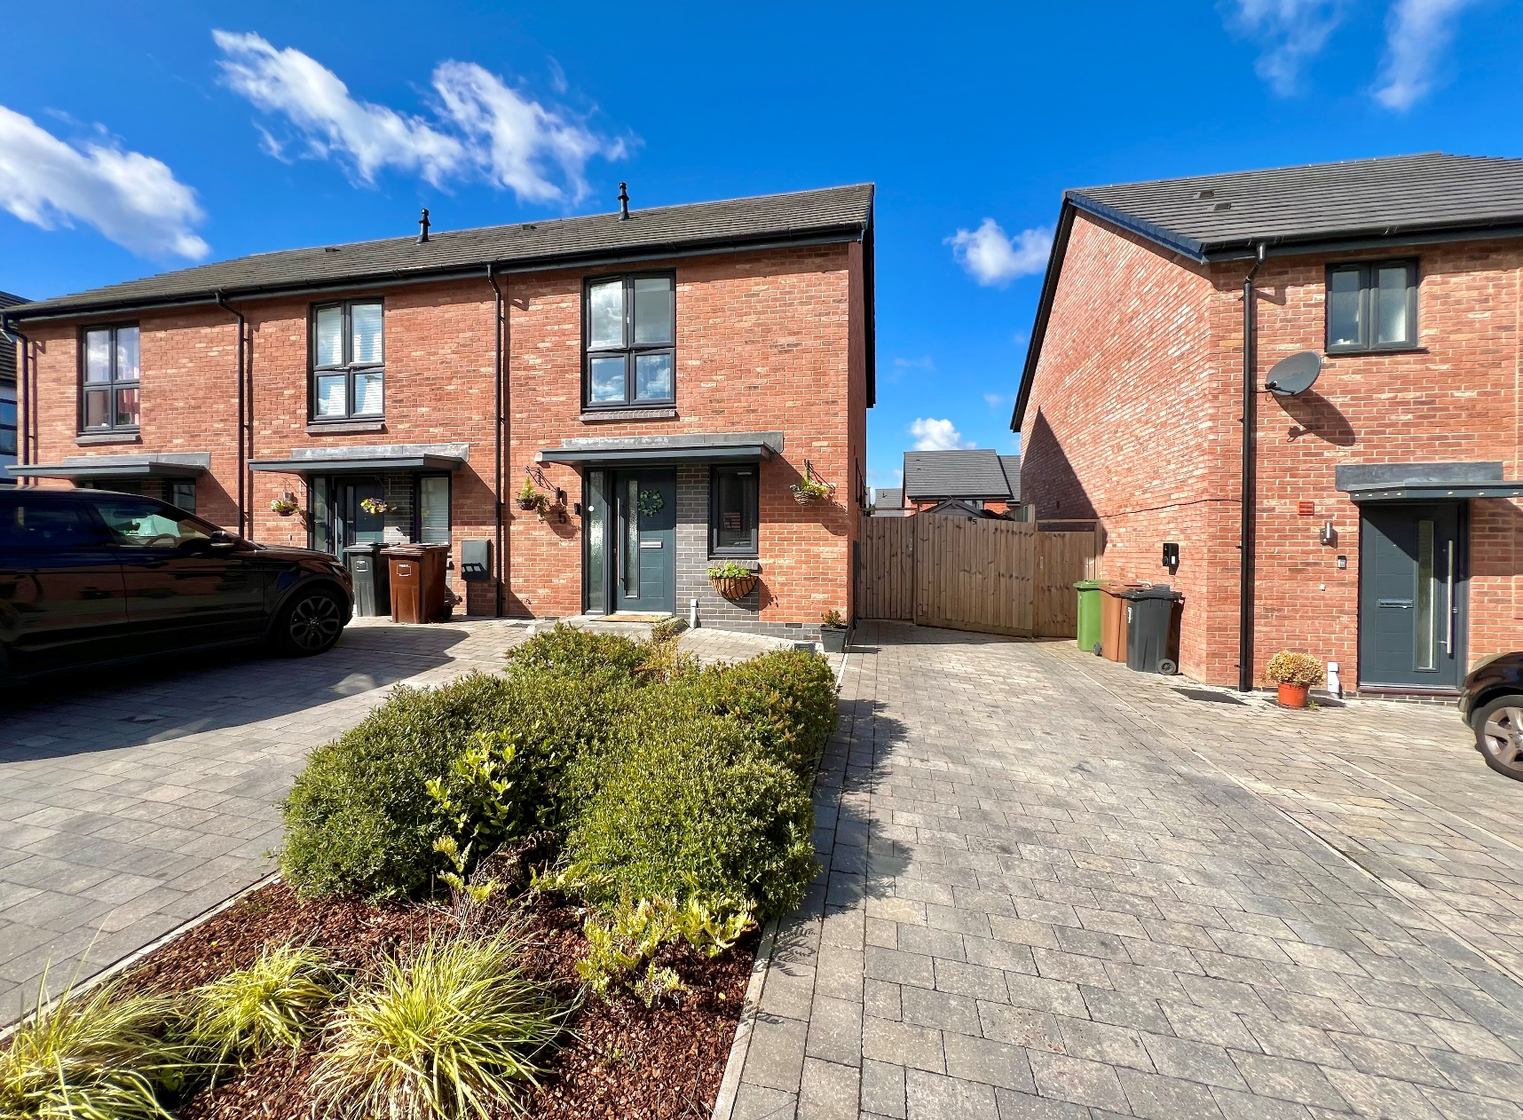
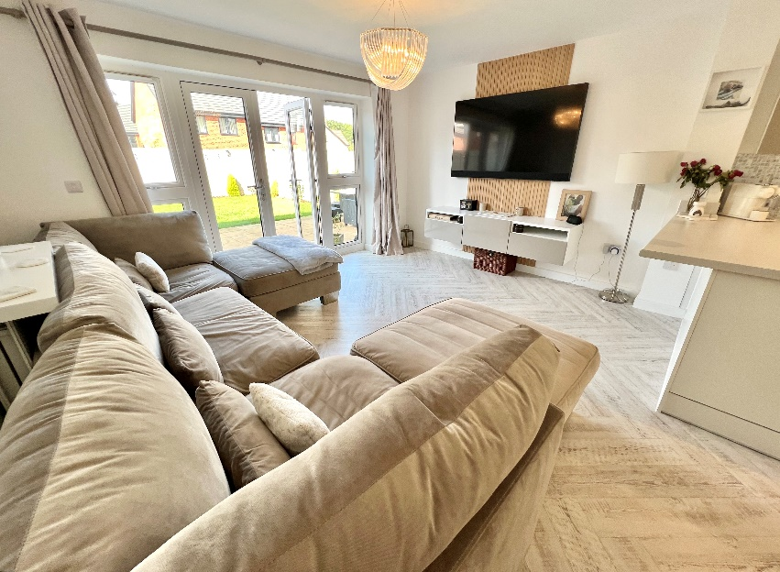
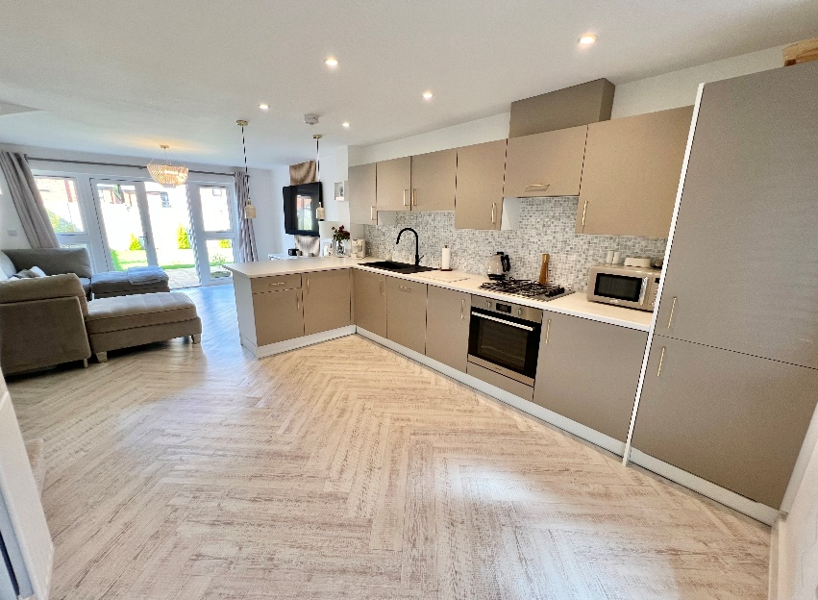
Magnolia Drive
Blythe Valley, Solihull
A Beautifully Presented Family Home
Two Double Bedrooms
Open Plan Lounge & Contemporary Kitchen
Landscaped South West Facing Rear Garden
£320,000
Current EPC Rating 83 (B)
Current Council Tax Band C

Slide 2
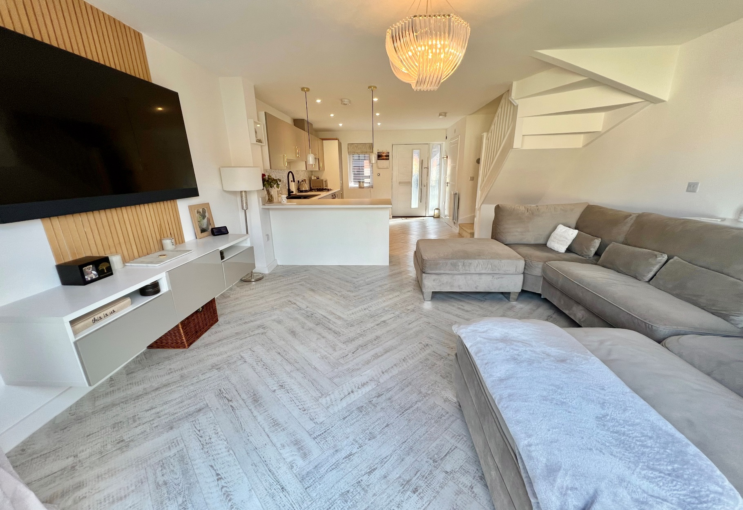
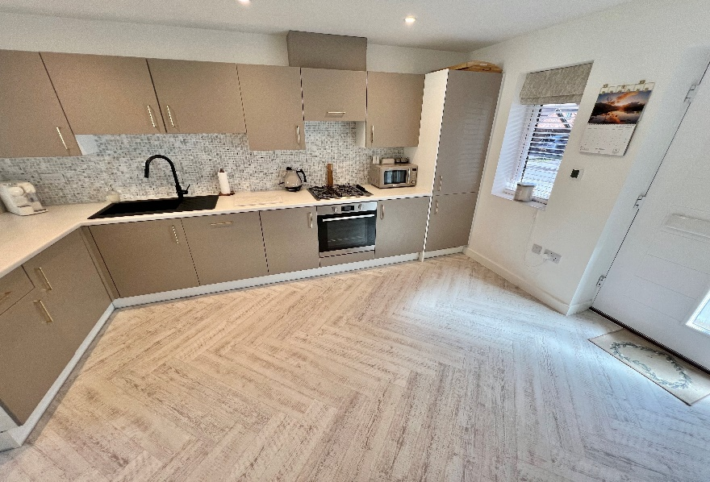
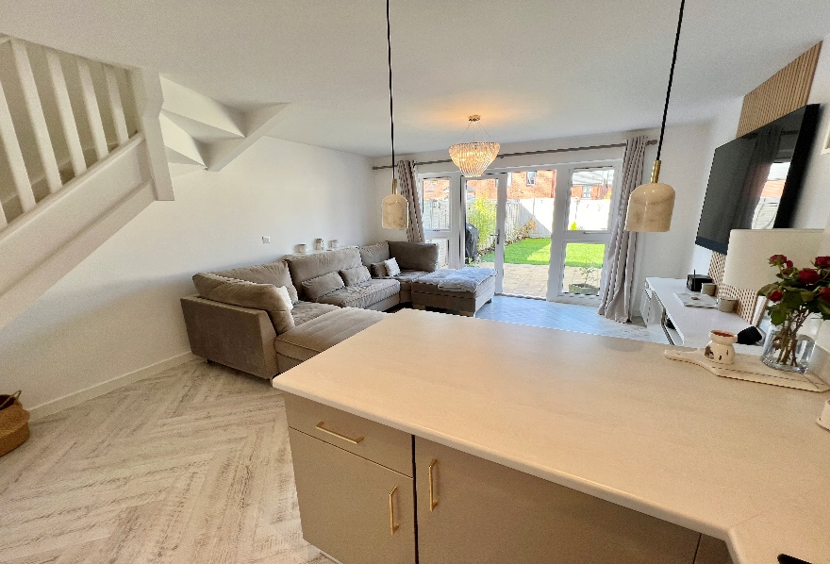
Property Description
A recently constructed and well presented end terrace property benefitting from two double bedrooms, open plan family dining kitchen, family bathroom, guest WC, landscaped South West facing rear garden and off road parking.
Blythe Valley is situated on the edge of Cheswick Green, Monkspath and open countryside, with easy access to the M42 linking to the M6, M40, M1 and M5 motorways, NEC Genting Arena, Resorts World and Birmingham International Airport and Railway Station. A wide selection of shopping facilities can be found along the A34 Stratford Road in Shirley, Sears Retail Park on Marshall Lake Road and Solihull Town Centre offers an excellent choice of shops including Touchwood Shopping Centre and John Lewis Department Store. Local schools are sort after with this property currently falling within Tudor Grange Academy catchment.

Slide 3
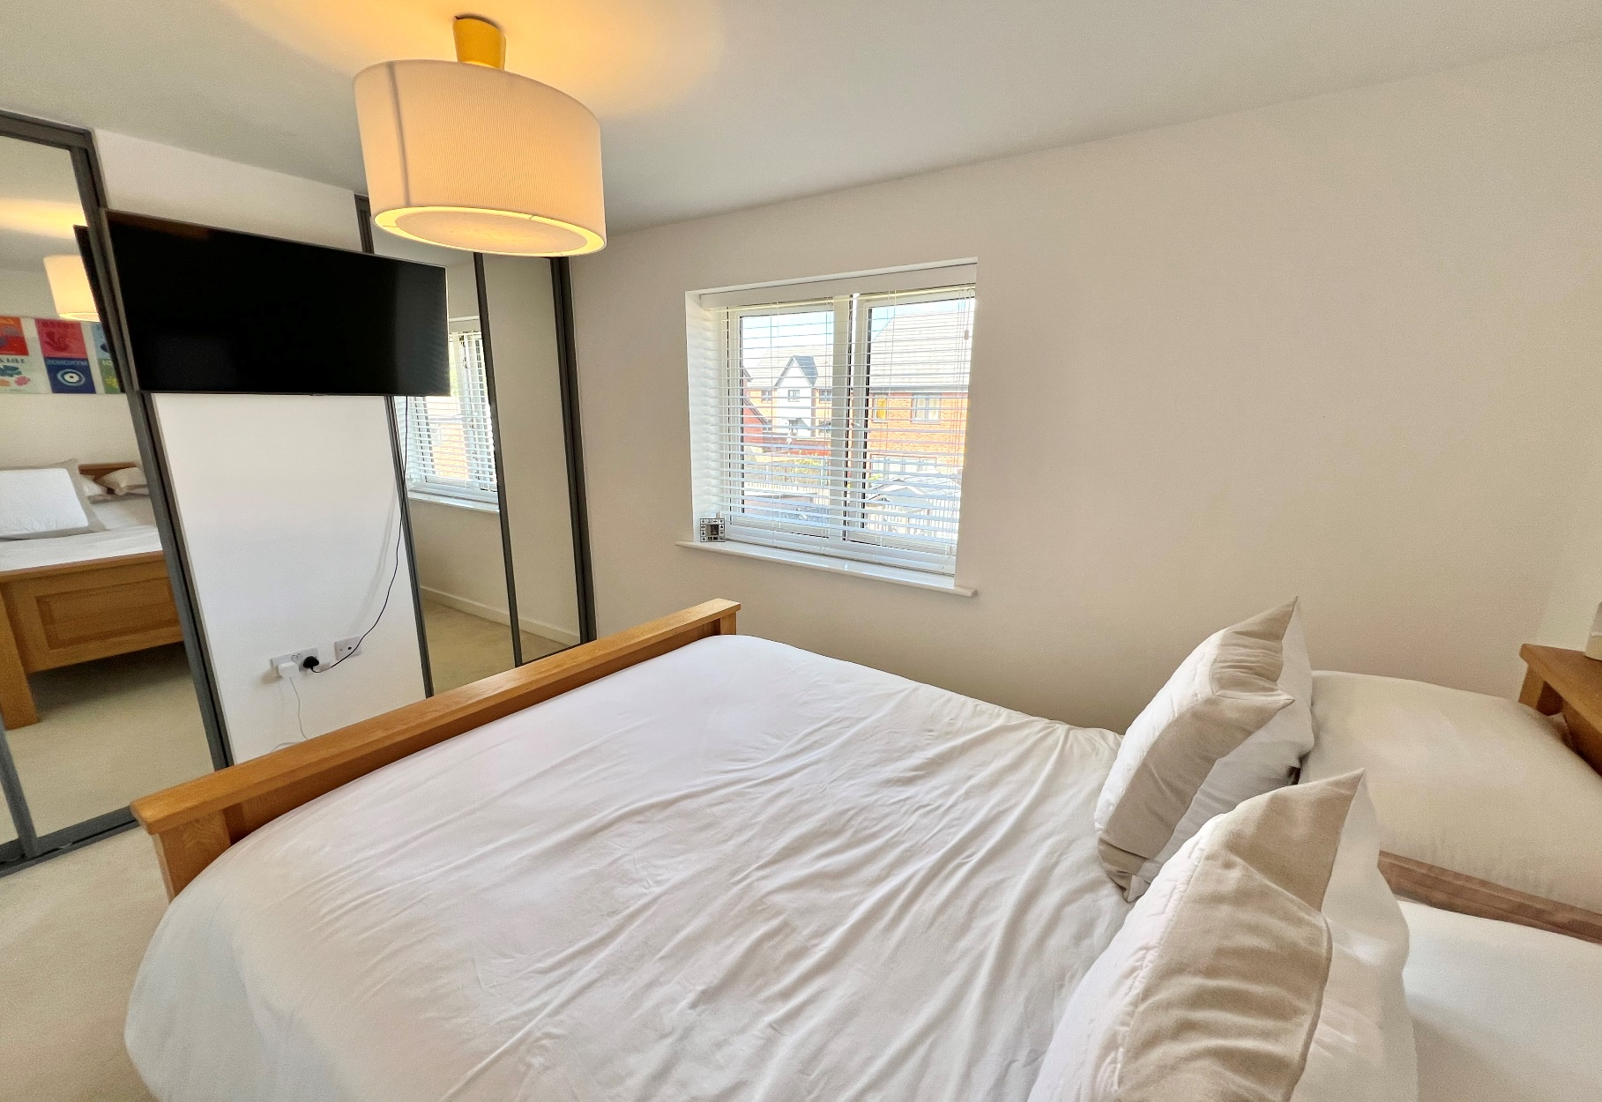
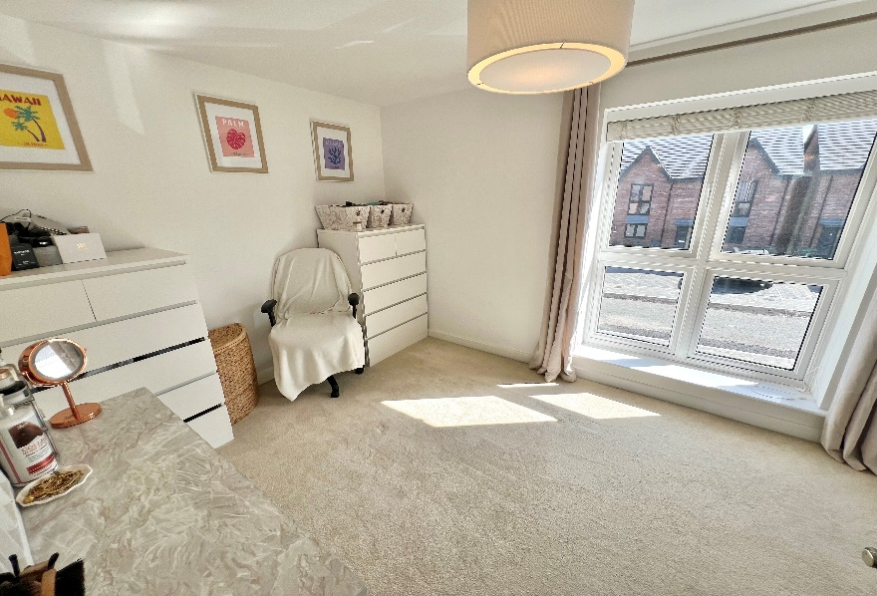
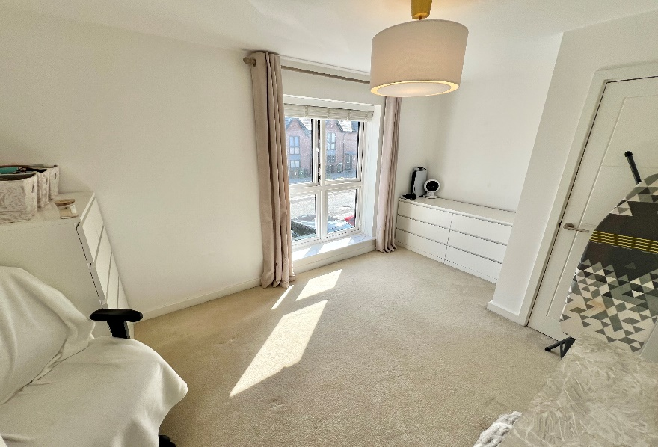
Rooms & Measurements
Open Plan Lounge & Kitchen - 8.13m x 4.14m max
(26'8" x 13’7”)
Guest WC
Bedroom One to Rear - 3.51m x 2.59m (11'6" x 8’6”)
Bedroom Two to Front - 4.14m x 2.67m (13'7" x 8’9”)
Family Bathroom - 2.06m x 1.98m (6'9" x 6’6”)
Landscaped South West Facing Rear Garden
Tenure
We are advised by the vendor that the property is freehold with an annual management fee of £270.00.
We would advise all interested parties to obtain verification through their own solicitor or legal representative.
EPC supplied by Vendor. Current council tax band – C

Slide 4
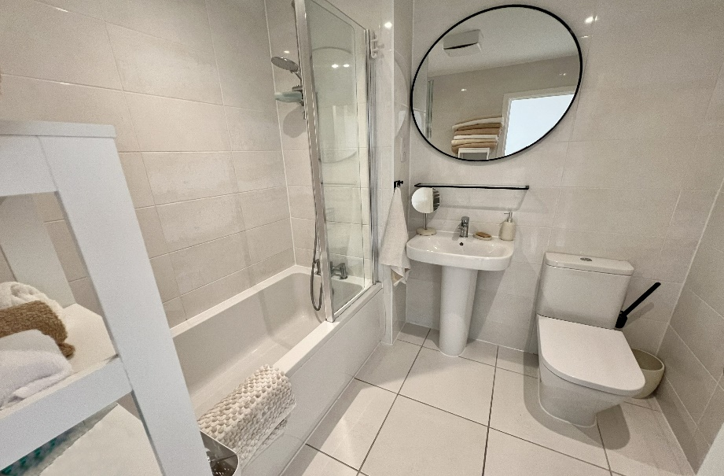
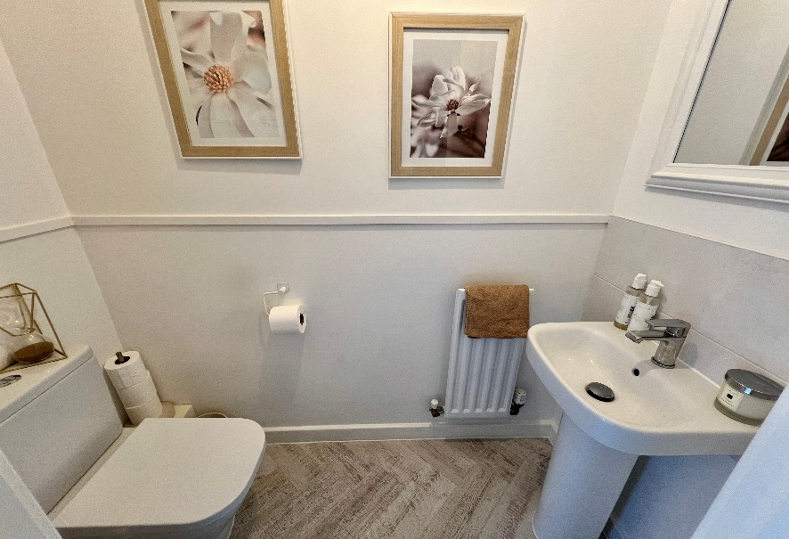
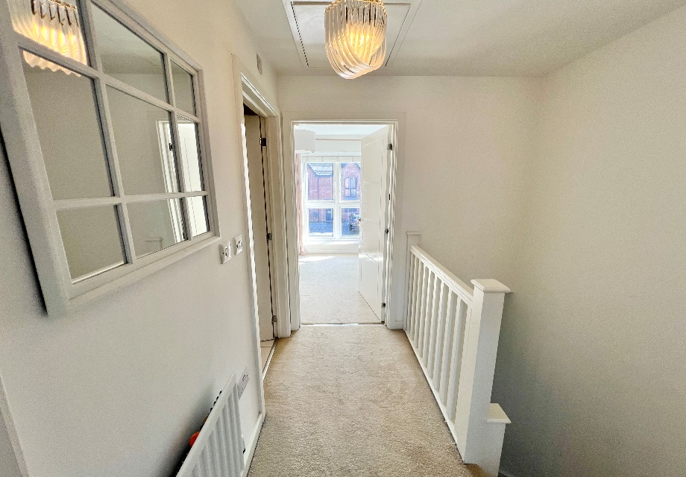
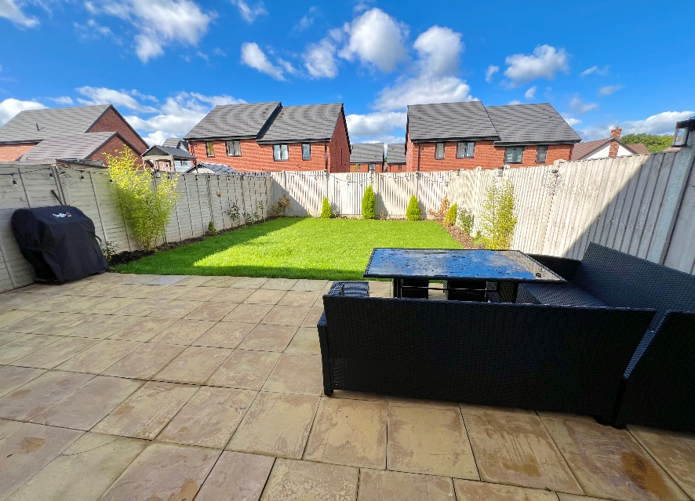
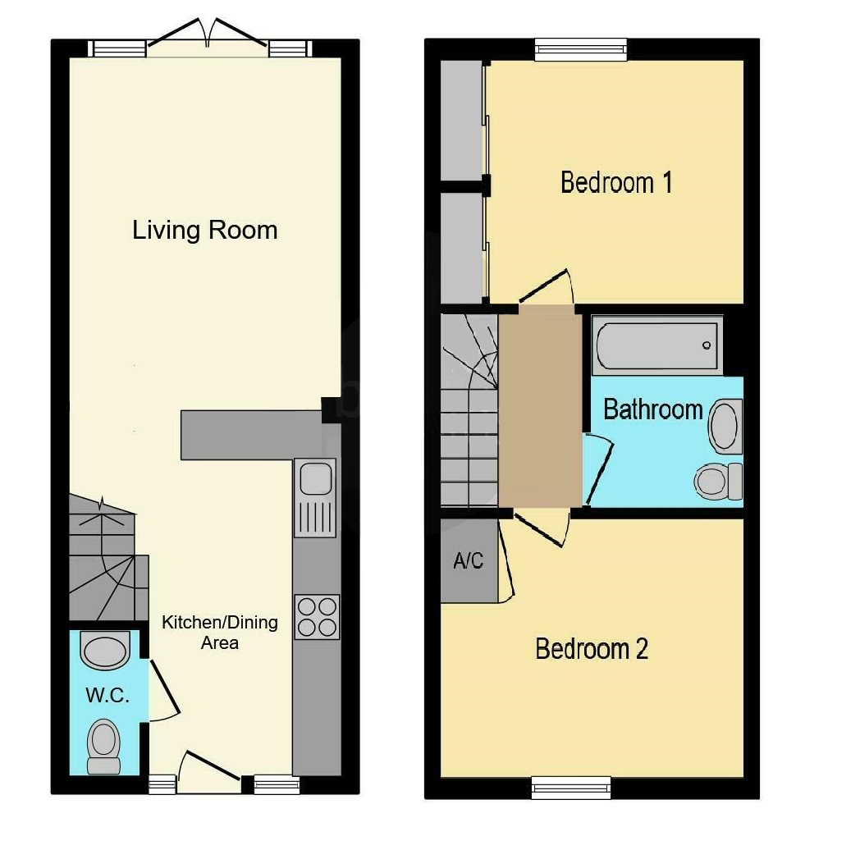
316 Stratford Road Shirley
Solihull B90 3DN
www.smart-homes.co.uk 0121 744 4144
Agents Note: Whilst every care has been taken to prepare these particulars, they are for guidance purposes only. We believe all information to be correct from the day of marketing however, we advise and recommend that your conveyancer and or surveyor verifies all information supplied. All measurements are approximate are for general guidance purposes only and whilst every care has been taken to ensure their accuracy, they should not be relied upon and potential buyers are advised to recheck the measurements.

